Slide 1
DIVIDE AND CONQUER AND SEGMENT TREES
Sanyam Garg

Slide 2

Master Method
T(n) = aT(n/b) + f(n) where a >= 1 and b > 1
There are following three cases:
1. If f(n) = Θ(nc) where c < Logba then T(n) = Θ(nLogba)
2. If f(n) = Θ(nc) where c = Logba then T(n) = Θ(ncLog n)
3.If f(n) = Θ(nc) where c > Logba then T(n) = Θ(f(n))

Slide 3
Tiling Problem using Divide and Conquer algorithm
Given a n by n board where n is of form 2k where k >= 1 (Basically n is a power of 2 with minimum value as 2). The board has one missing cell (of size 1 x 1). Fill the board using L shaped tiles. A L shaped tile is a 2 x 2 square with one cell of size 1×1 missing.

Slide 4
INVERSION COUNT
https://www.spoj.com/problems/INVCNT/

Slide 5
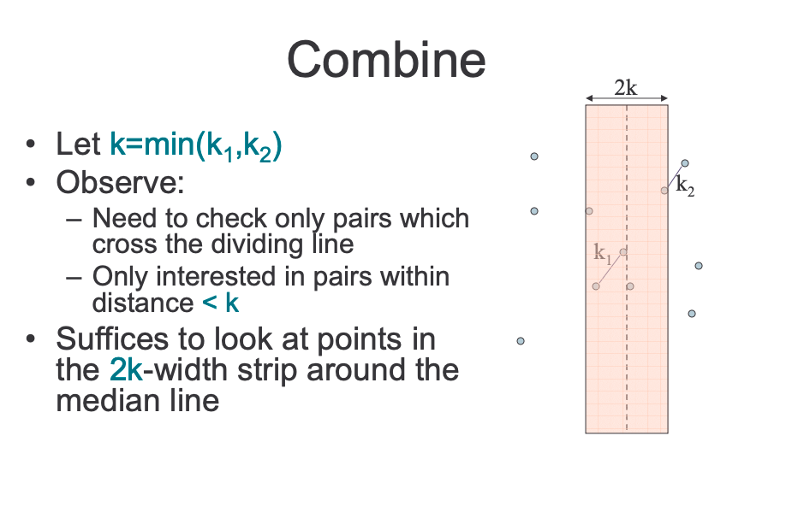
CLOSEST PAIR OF POINTS

Slide 6
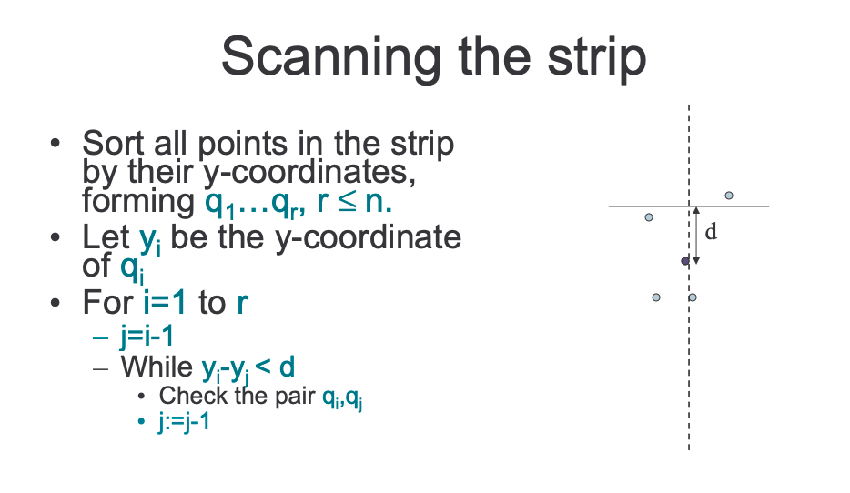
CLOSEST PAIR OF POINTS

Slide 7
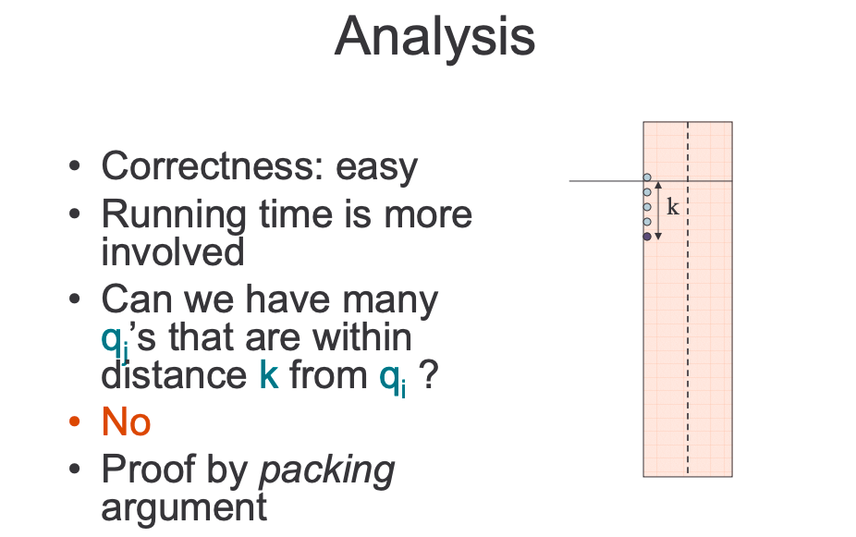
CLOSEST PAIR OF POINTS

Slide 8
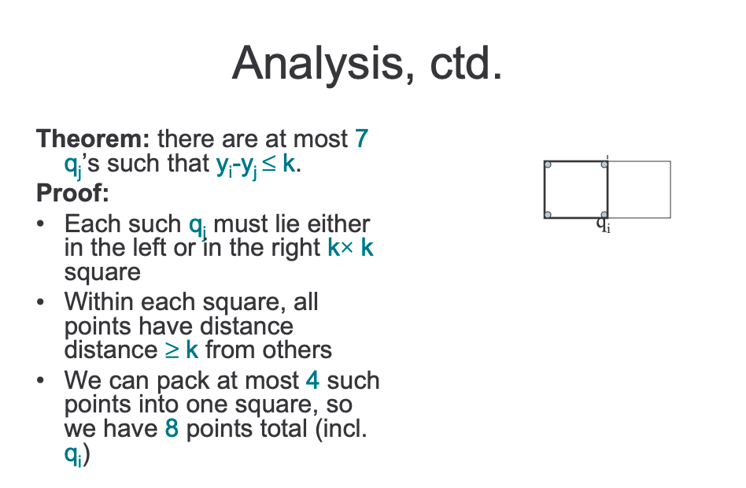
CLOSEST PAIR OF POINTS

Slide 9
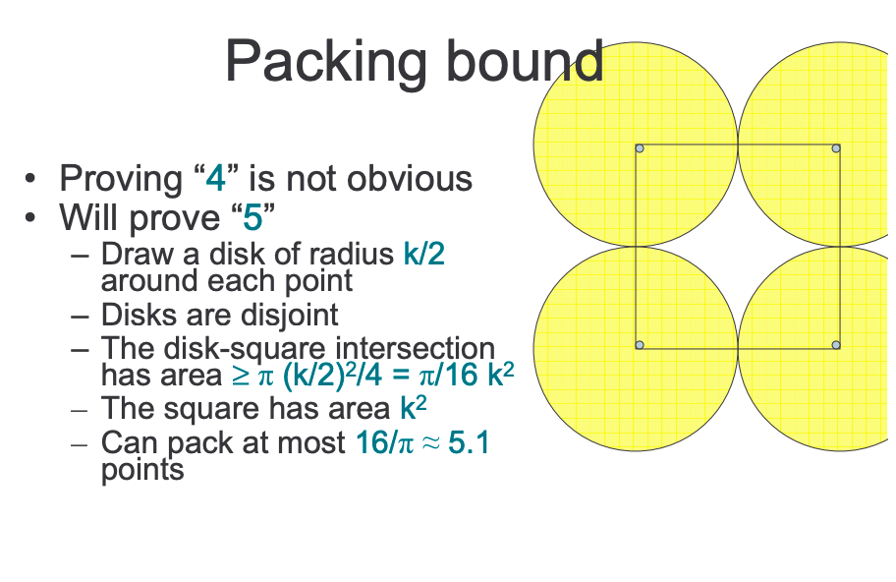
CLOSEST PAIR OF POINTS

Slide 10
CLOSEST PAIR OF POINTS
Bibliography : http://people.csail.mit.edu/indyk/6.838-old/handouts/lec17.pdf
QUESTION :
https://www.spoj.com/problems/CPP/

Slide 11
SEGMENT TREES
RANGE MINIMUM QUERY
BUILD : O(N)
QUERY : O(logN)
UPDATE : O(logN)

Slide 12
RANGE SUM USING SEGMENT TREES

Slide 13
LAZY PROPAGATION
https://www.spoj.com/problems/HORRIBLE/

Slide 14
GSS1 SPOJ
https://www.spoj.com/problems/GSS1/

Slide 15
GSS3 SPOJ
https://www.spoj.com/problems/GSS3/

